Slide 1
Course contents
Digital design
Combinatorial circuits: without status
Sequential circuits: with status
FSMD design: hardwired processors
Language based HW design: VHDL

Slide 2
Design of Combinatorial Circuits
Minimization of Boolean functions
Technology mapping
Correct timing behavior
Basic RTL building blocks (Adder, ALU, MUX, …)

Slide 3
Design of Combinatorial Circuits
Minimization of Boolean functions
  Karnaugh map
  Minimization with the Karnaugh map
  Don’t care conditions
  Quine-McCluskey
Technology mapping
Correct timing behavior
Basic RTL building blocks (Adder, ALU, MUX, …)

Slide 4
Design of Combinatorial Circuits
Minimization of Boolean functions
  Karnaugh map
  Minimization with the Karnaugh map
  Don’t care conditions
  Quine-McCluskey
Technology mapping
Correct timing behavior
Basic RTL building blocks (Adder, ALU, MUX, …)

Slide 5
Karnaugh map
Motivation:
  Assume: F=xy’z+xy’z’
  Cost = Σ(fan-in)_{complete circuit} = (2)+(3)+(3)+(2) = 10
  Delay
    Assume: relative gate delay NAND or NOR or NOT = 0.6 + fan-in * 0.4
    Delay = Σ(gate-delay)_{critical path} = 1 + (1.8+1) + (1.4+1) = 6.2
x
y
z
F=xy’z+xy’z’

Slide 6
Karnaugh map
Motivation:
  F =xy’z+xy’z’
  =xy’(z+z’)
  =xy’
  The value of z hence does not matter
  Cost = Σ(fan-in)_{complete circuit} = (1+2) = 3 i.o. 10
  Delay
    Assume: relative gate delay NAND or NOR or NOT = 0.6 + fan-in * 0.4
    Delay = Σ(gate-delay)_{critical path} = 1 + (1.4+1) = 3.4 i.o. 6.2
x
y
z
F

Slide 7
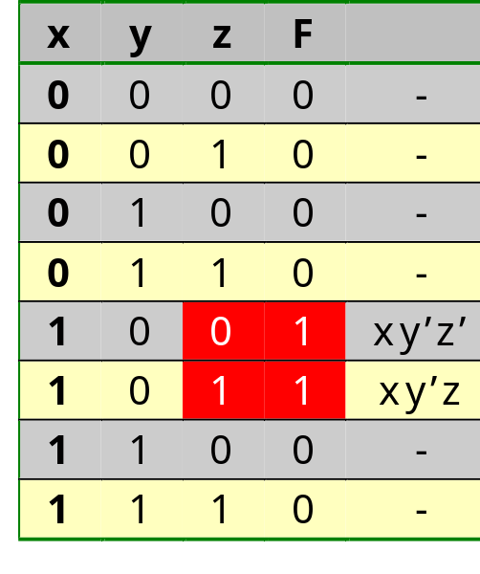
Karnaugh map
Minimization via manipulation of Boolean expressions is clumsy: no method exists to select the theorems such that we are sure to obtain the minimum cost
Is it possible to see in the truth table which input value does not matter?
We indeed see easily that the
value of F equals 1 for x=1 and y=0
irrespective of the value of z
We however see this easily only
for z, since only for z the lines
z=0 and z=1 for equal x and y
are consecutive

Slide 8
Karnaugh map
A Karnaugh map contains the same information as a truth table (each square is a minterm), but…
neighboring squares differ only in the value of 1 variable!!
x
y
0
1
x
0
1
x’
x
x’y’
x’y
0
z
xy’
xy
1
y
yz
x
00
01
11
10
xy’ (z does not matter)
x’y’z’
x’y’z
x’y’z
x’yz
x’yz
x’yz’
0
x’z (y does not matter)
xy’z’
xz’ (y does not matter)
xy’z’
xy’z’
xy’z
xy’z
xyz
xyz’
xyz’
x
1

Slide 9
Karnaugh map
x
y
0
1
x
0
1
m₀
m₁
m₀
m₁
0
m₂
m₃
1
z
y
yz
x
00
01
11
10
0
1
3
2
0
4
5
7
6
x
1

Slide 10
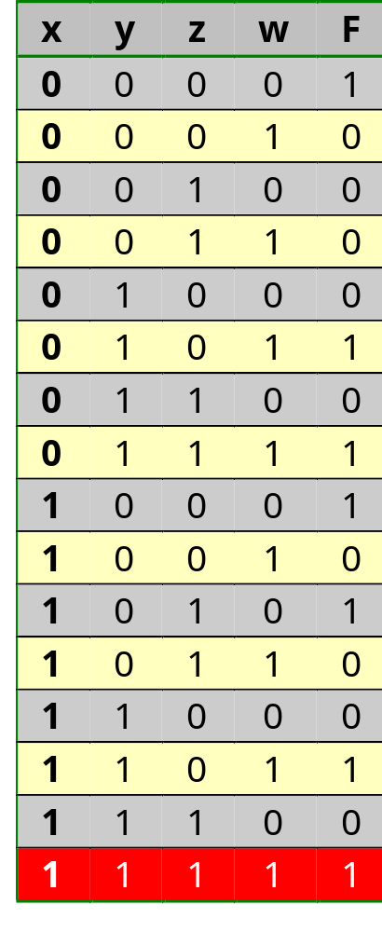
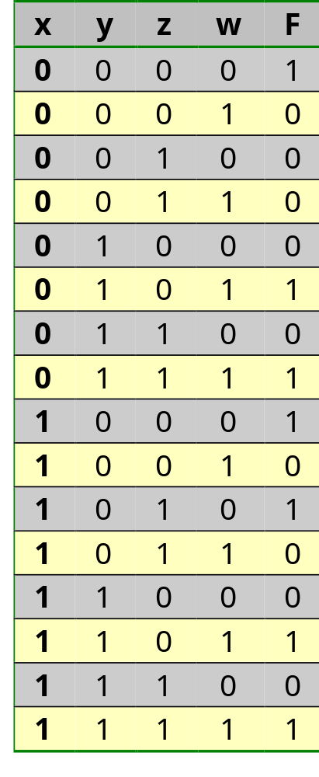
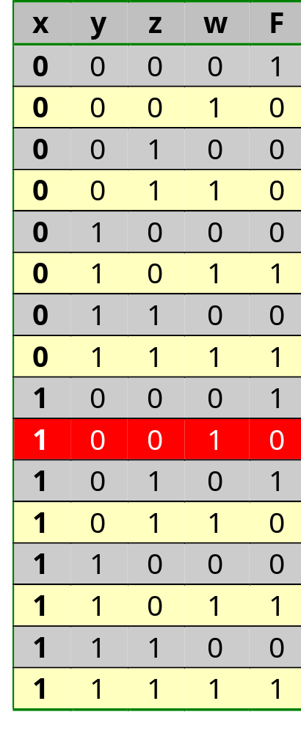
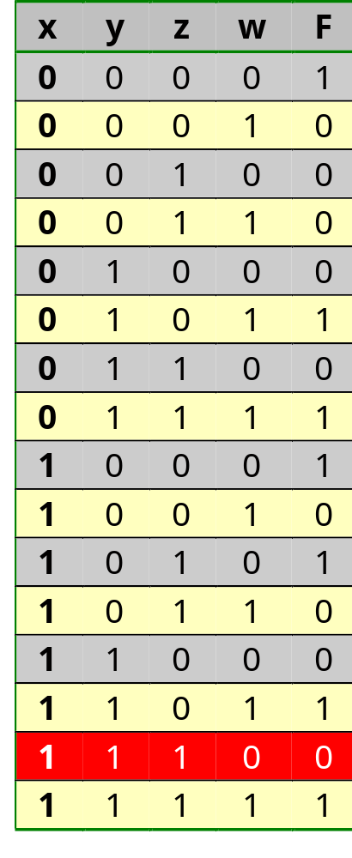
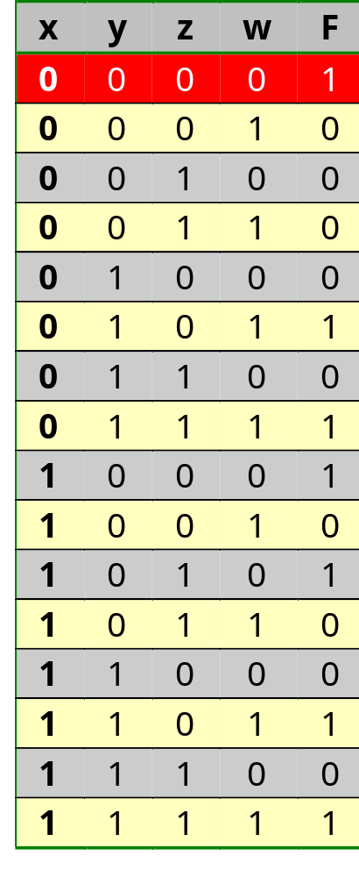
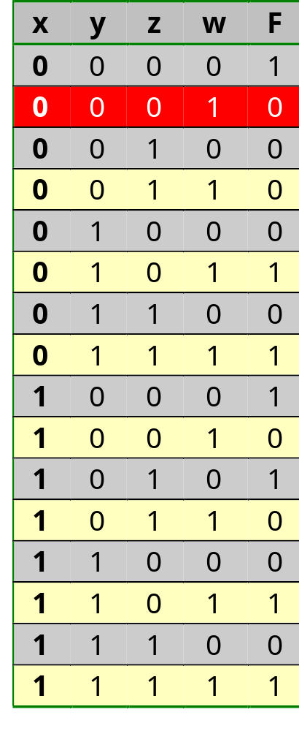
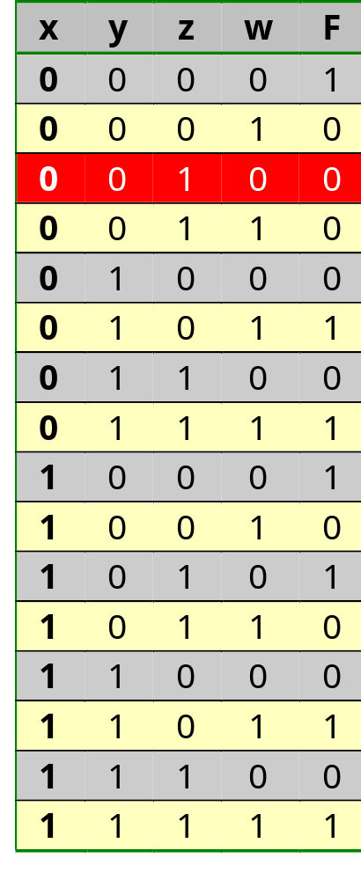
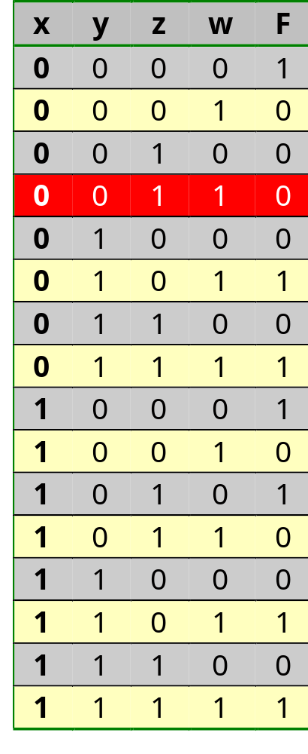
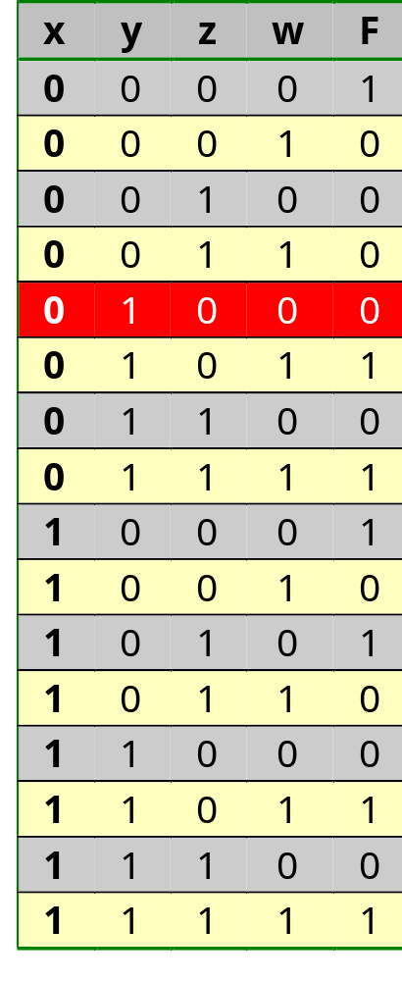
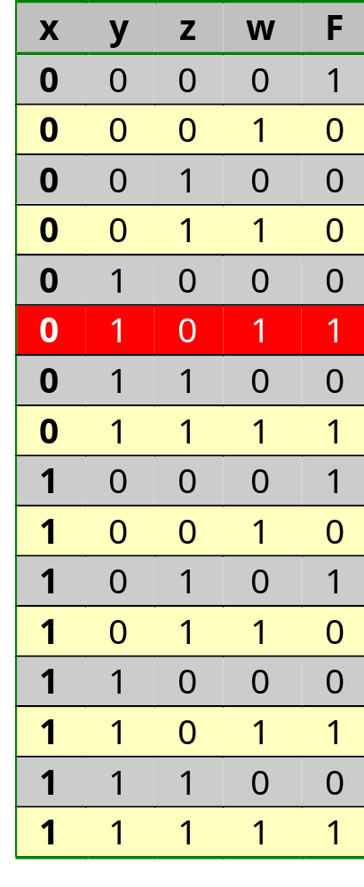
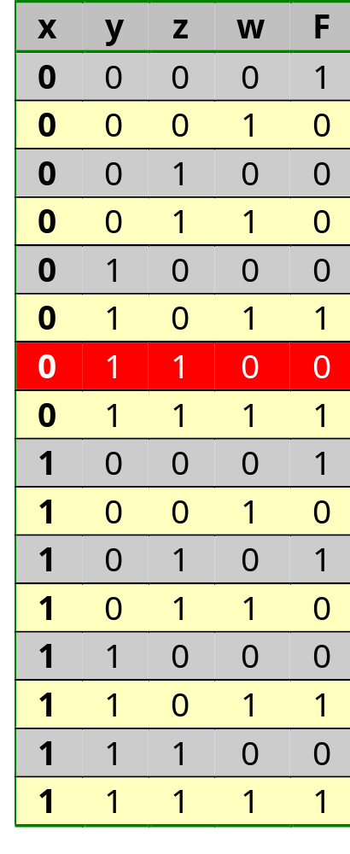
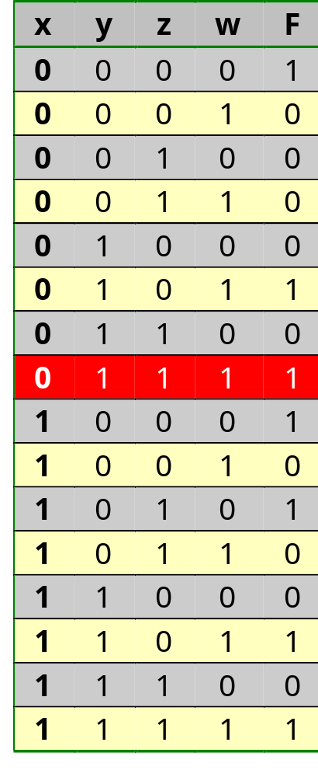
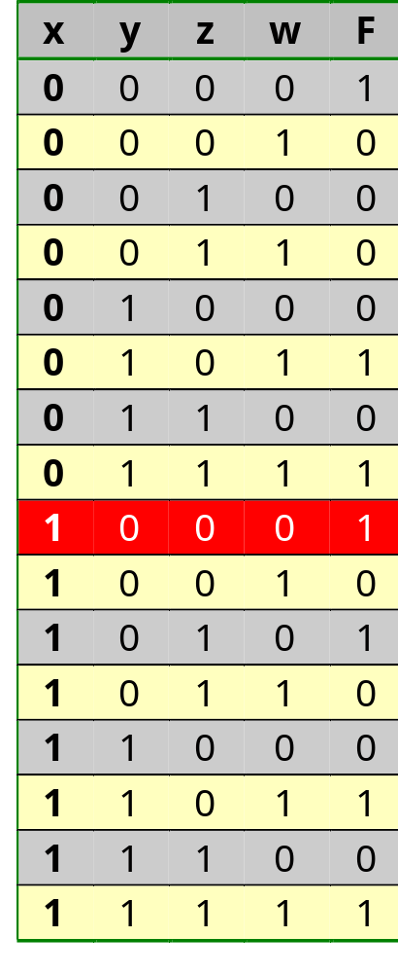
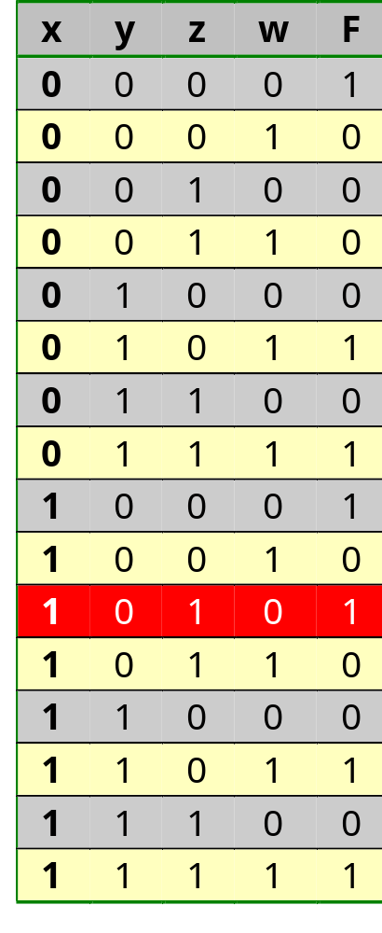
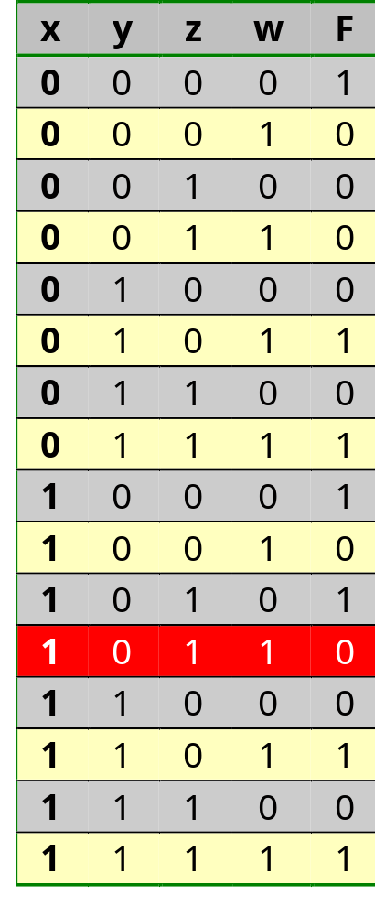
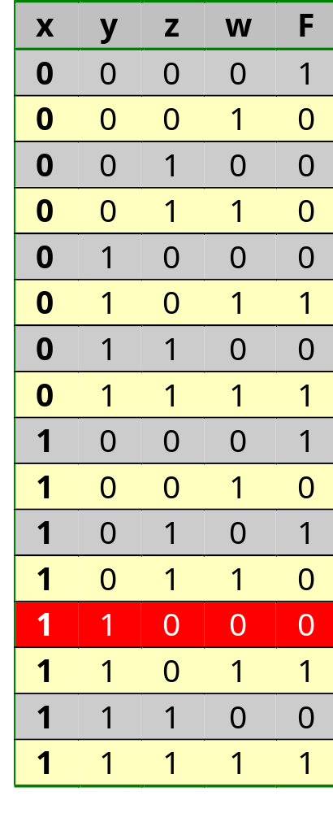
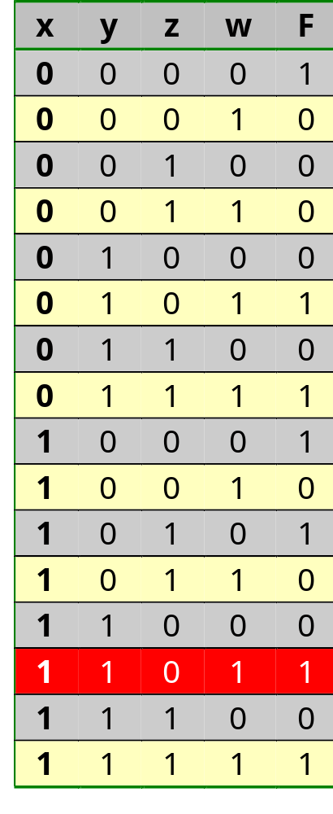
Karnaugh map
Fill out from truth table
w
z
zw
xy
00
01
11
10
0
1
3
2
1
0
0
0
00
4
5
7
6
0
1
1
0
01
y
12
13
15
1
14
0
1
0
11
x
8
9
1
0
11
10
0
1
10

Slide 11
Karnaugh map
Minimize
F=x’y’z’w’+x’yz’w+x’yzw+xy’z’w’+xy’zw’+xyz’w+xyzw
w
z
zw
xy
00
01
11
10
1
0
0
0
00
0
1
1
0
F=
yw
01
+xy’w’
y
0
1
1
0
+y’z’w’
11
x
1
0
0
1
10

Slide 12
Karnaugh map
Implement
F=x’y’z’w’+x’yz’w+x’yzw+xy’z’w’+xy’zw’+xyz’w+xyzw
x
y
z
w
Cost = 4*(1) + 7*(4) + 1*(7)
= 39
Delay = 1 + (2.2+1) + (3.4+1)
= 8.6
F

Slide 13
Karnaugh map
Implement
F=yw+xy’w’+y’z’w’
x
y
z
w
F
Cost = 3*(1) + {1*(2)+2*(3)} + 1*(3)
= 14 i.p.v. 39
Delay = 1 + (1.8+1) + (1.8+1)
= 6.6 i.p.v. 8.6

Slide 14
Karnaugh map
v
w
w
z
z
zw
00
01
11
10
10
11
01
00
xy
xy
00
0
1
3
2
18
19
17
16
00
01
4
5
7
6
22
23
21
20
01
y
y
11
12
13
15
14
30
31
29
28
11
x
x
10
8
9
11
10
26
27
25
24
10
F(v,x,y,z,w)
Differs from course book

Slide 15
Karnaugh map
v
Differs from course book
w
w
z
z
zw
00
01
11
10
10
11
01
00
xy
xy
00
0
1
3
2
18
19
17
16
00
01
4
5
7
6
22
23
21
20
01
y
11
12
13
15
14
30
31
29
28
11
y
x
x
10
8
9
11
10
26
27
25
24
10
F=(u,v,x,y,z,w)
10
40
41
43
42
58
59
57
56
10
x
x
11
44
45
47
46
62
63
61
60
11
y
y
u
01
36
37
39
38
54
55
53
52
01
00
32
33
35
34
50
51
49
48
00

Slide 16
Design of Combinatorial Circuits
Minimization of Boolean functions
  Karnaugh map
  Minimization with the Karnaugh map
  Don’t care conditions
  Quine-McCluskey
Technology mapping
Correct timing behavior
Basic RTL building blocks (Adder, ALU, MUX, …)

Slide 17
Minimization with the Karnaugh map
Truth table or
canonical form
Create the Karnaugh map
Determine all prime implicants
Determine all essential
prime implicants
Search for minimal coverage

Slide 18
Minimization with the Karnaugh map
F=x’y’z’+wz+xyz+w’y
F=x’y’z’+wz+xyz+w’y
F=x’y’z’+wz+xyz+w’y
F=x’y’z’+wz+xyz+w’y
F=x’y’z’+wz+xyz+w’y
Step 1: Create Karnaugh map
z
y
1
1
1
1
1
1
1
1
x
1
1
1
1
1
1
w
1
1
1
1
1
1
Rule:
- Take product term per product
term and indicate where in the
Karnaugh map it equals 1

Slide 19
Minimization with the Karnaugh map
Step 2: Determine all prime implicants
z
w’x’z’
y
x’y’z’
w’y
1
1
1
1
1
1
1
1
1
1
yz
1
wz
1
1
1
1
1
x
wx’y’
1
1
1
1
1
1
w
1
1
1
1
1
1
1
1
Rule:
- Analyze each 1-minterm
- Determine the largest sub-cube(s)
that contain(s) the minterm and
add them to the list of prime
implicants (without adding an
already listed sub-cube)

Slide 20
Minimization with the Karnaugh map
Step 3: Determine all essential prime implicants
z
w’x’z’
y
x’y’z’
w’y
w’y
1
1
1
yz
wz
1
1
wz
1
x
wx’y’
1
1
1
w
1
1
1
Rule:
- Search for 1-minterms that are
only contained in 1 prime implicant
- Indicate this prime implicant as
essential

Slide 21
Minimization with the Karnaugh map
Step 4: Search minimal coverage
z
w’x’z’
1
y
x’y’z’
x’y’z’
2
w’y
1
1
1
1
1
1
yz
0
1
wz
1
1
1
x
wx’y’
1
1
1
1
1
w
F_{min}=x’y’z’+w’y+wz
1
1
1
1
1
1
Rule:
- Goal: search for the smallest set of (as big as possible)
prime implicants that contain all 1-minterms
- Take all essential prime implicants as initial list
- Repeatedly add a prime implicant to the list that contains
the largest number of not yet covered 1-minterms. When
there are two that contain the same number of not yet
covered 1-minterms, make a random choice.
- Such a strategy is known as Greedy strategy: at each decision point,
take the best choice without looking to future implications
- This does not always lead to a global optimum

Slide 22
Minimization with the Karnaugh map
Original:
F=x’y’z’+w’y+xyz+wz
Minimal
F_{min}=x’y’z’+w’y+wz
wxyz
wxyz
Cost=4*1+2*3+2*2+1*4=18
Cost =4*1+1*3+2*2+1*3=14
=22% cheaper
Delay =(1)+(.6+3*.4+1)
+(.6+4*.4+1)=7
Delay =(1)+(.6+3*.4+1)
+(.6+3*.4+1)=6.6
=6% faster

Slide 23
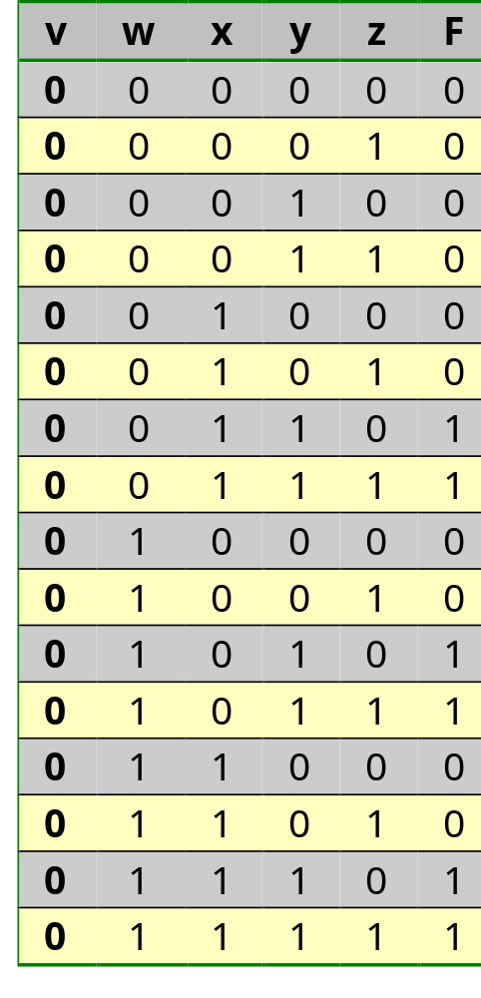
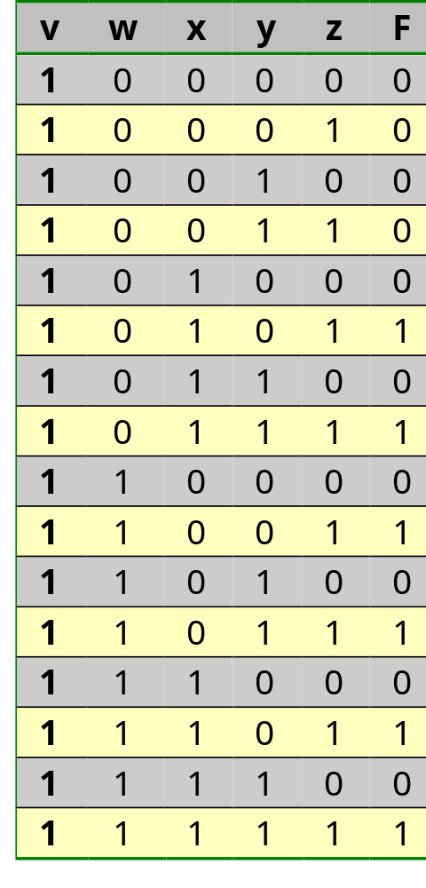
Minimization with the Karnaugh map
Example 2: F(v,w,x,y,z)

Slide 24
Minimization with the Karnaugh map
Realisation as sum of 1-minterms: F=Σ(6,7,10,11,14,15,21,23,25,27,29,31)
v
w
x
y
z
Cost=(5*1)+(12*(5+1))+(1*(12+1))=90
Delay=(.6+1*.4)+(.6+5*.4+1)+(.6+12*.4+1)=11

Slide 25
Minimization with the Karnaugh map
Minimisation
Step 1: Create Karnaugh map
v
z
z
y
0
0
0
0
0
0
0
0
0
0
1
1
0
1
1
0
x
0
0
1
1
0
1
1
0
w
0
0
1
1
0
1
1
0

Slide 26
Minimization with the Karnaugh map
Minimisation
Step 2: determine all prime implicants
v
z
z
y
0
0
0
0
0
0
0
0
0
0
1
1
0
1
1
0
x
0
0
1
1
0
1
1
0
w
0
0
1
1
0
1
1
0

Slide 27
Minimization with the Karnaugh map
Minimisation
Step 3: Determine all essential prime implicants
v
z
z
y
0
0
0
0
0
0
0
0
0
0
1
1
1
0
1
1
1
0
x
0
0
1
1
0
1
1
0
w
0
0
1
1
1
0
1
1
1
0
Is already the minimum coverage
F_{1min2}=v’xy+v’wy+vxz+vwz

Slide 28
Minimization with the Karnaugh map
Realisation of F_{1min2}=v’xy+v’wy+vxz+vwz
v
w
x
y
z
Cost=1+(4*(3+1))+(1*(4+1))=22 (76% cheaper)
Delay=(.6+1*.4)+(.6+3*.4+1)+(.6+4*.4+1)=7 (34% faster)

Slide 29
Minimization with the Karnaugh map
Realisation in more than two layers
F =v’xy+v’wy+vxz+vwz
=v’y(x+w)+vz(x+w)
=(x+w)(v’y+vz)
v
Cost =(1*1)+(5*(2+1))=16
(82% cheaper)
Delay =(.6+1*.4)+(.6+2*.4+1)
+(.6+2*.4+1)+(.6+2*.4+1)
=8.2 (25% faster)
w
x
y
z

Slide 30
Minimization with the Karnaugh map
Dual minimisation
Step 1: Create the Karnaugh map
v
z
z
y
0
0
0
0
0
0
0
0
0
0
1
1
0
1
1
0
x
0
0
1
1
0
1
1
0
w
0
0
1
1
0
1
1
0

Slide 31
Minimization with the Karnaugh map
Dual minimisation
Step 2: Determine all prime implicants
v
z
z
y
0
0
0
0
0
0
0
0
0
0
1
1
0
1
1
0
x
0
0
1
1
0
1
1
0
w
0
0
1
1
0
1
1
0

Slide 32
Minimization with the Karnaugh map
Dual minimisation
Step 3: Determine all essential prime implicants
v
z
z
y
0
0
0
0
0
0
0
0
0
0
0
0
0
0
0
1
1
0
0
1
1
0
x
0
0
0
1
1
0
0
1
1
0
w
0
0
0
1
1
0
0
1
1
0
Is already the minimum coverage
F_{0min2}=(v+y)(w+x)(v’+z)

Slide 33
Minimization with the Karnaugh map
Realisation of F_{0min2}=(v+y)(w+x)(v’+z)
v
w
x
y
z
Cost=(1*1)+(3*(2+1))+(1*(3+1))=14 (84% cheaper)
Delay=(.6+1*.4)+(.6+2*.4+1)+(.6+3*.4+1)=6.2 (44% faster)

Slide 34
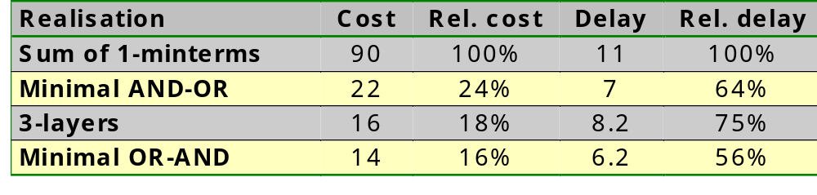
Minimization with the Karnaugh map
Summary
Area/time trade-off
We’ll see that, depending on the technology mapping,
we will eventually obtain for an ASIC realisation:
OR-AND-INV
Cost = 11 (Rel. cost=12%)
Delay = 4 (Rel. delay=36%)
NOR
Cost = 10 (Rel. cost=11%)
Delay = 4.2 (Rel. delay=38%)

Slide 35
Design of Combinatorial Circuits
Minimization of Boolean functions
  Karnaugh map
  Minimization with the Karnaugh map
  Don’t care conditions
  Quine-McCluskey
Technology mapping
Correct timing behavior
Basic RTL building blocks (Adder, ALU, MUX, …)

Slide 36
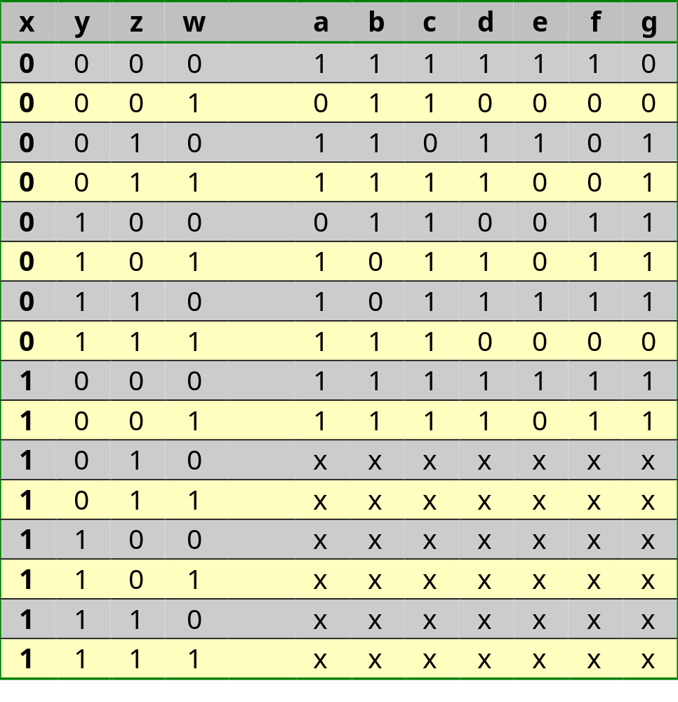
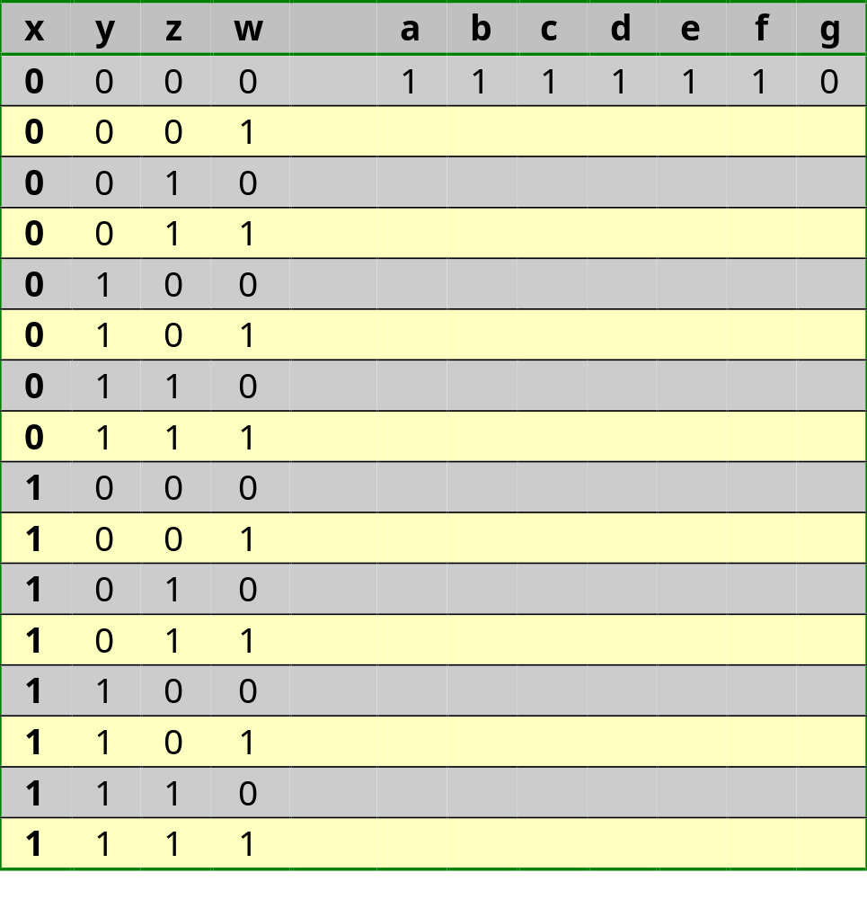
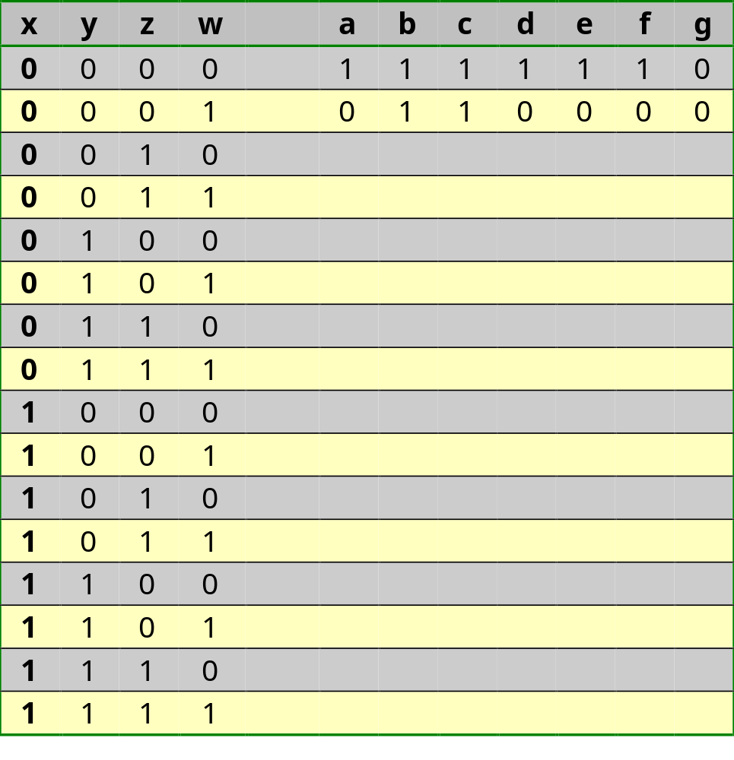
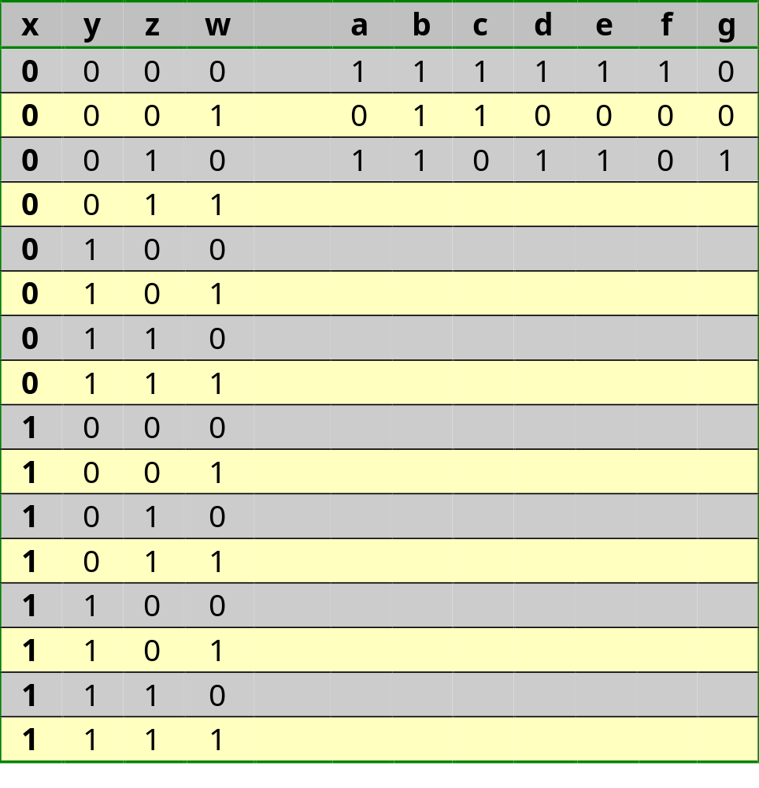
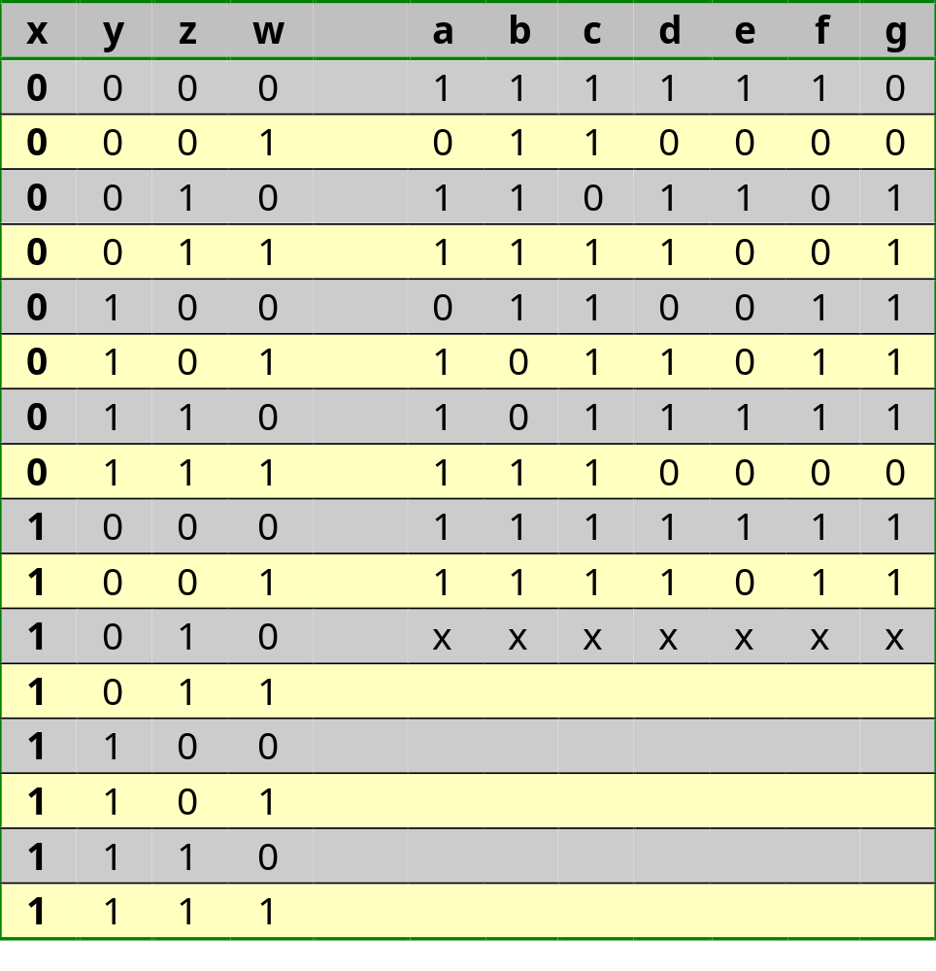
Don’t care conditions
Incompletely specified Boolean function
BCD→7-segment
a
f
b
g
e
c
d

Slide 37
Don’t care conditions
Step 1: Create Karnaugh maps
w
w
w
w
a
z
b
z
c
z
d
z
1
0
1
1
1
1
1
1
1
1
1
0
1
0
1
1
0
1
1
1
1
0
1
0
1
1
1
1
0
1
0
1
y
x
x
x
x
x
x
x
x
x
x
x
x
x
x
x
x
x
1
1
x
x
1
1
x
x
1
1
x
x
1
1
x
x
e
f
g
1
0
0
1
1
0
0
0
0
0
1
1
0
0
0
1
1
1
0
1
1
1
0
1
y
x
x
x
x
x
x
x
x
x
x
x
x
x
1
0
x
x
1
1
x
x
1
1
x
x

Slide 38
Don’t care conditions
Step 2: determine all prime implicants
w
w
w
w
a
z
b
z
c
z
d
z
1
0
1
1
1
1
1
1
1
1
1
0
1
0
1
1
0
1
1
1
1
0
1
0
1
1
1
1
0
1
0
1
y
x
x
x
x
x
x
x
x
x
x
x
x
x
x
x
x
x
1
1
x
x
1
1
x
x
1
1
x
x
1
1
x
x
e
f
g
1
0
0
1
1
0
0
0
0
0
1
1
0
0
0
1
1
1
0
1
1
1
0
1
y
x
x
x
x
x
x
x
x
x
x
x
x
x
1
0
x
x
1
1
x
x
1
1
x
x

Slide 39
Don’t care conditions
Step 3: Determine all essential prime implicants
w
w
w
w
a
z
b
z
c
z
d
z
1
0
1
1
1
1
1
1
1
1
1
0
1
0
1
1
0
1
1
1
1
0
1
0
1
1
1
1
0
1
0
1
y
x
x
x
x
x
x
x
x
x
x
x
x
x
x
x
x
x
1
1
x
x
1
1
x
x
1
1
x
x
1
1
x
x
Complete
coverage
Complete
coverage
Complete
coverage
Complete
coverage
e
f
g
1
0
0
1
1
0
0
0
0
0
1
1
0
0
0
1
1
1
0
1
1
1
0
1
y
x
x
x
x
x
x
x
x
x
x
x
x
x
1
0
x
x
1
1
x
x
1
1
x
x
Complete
coverage
Complete
coverage
Incomplete
coverage

Slide 40
Don’t care conditions
Step 4: Determine minimum coverage
g
Selection of the cube that realises
the remaining minterm:
- Select all cubes that realise
the minterm and are already
essential for another function;
in this case, both are already
essential
- Select that cube that appears
in the smallest number of
other functions to keep the
fan-out as low as possible
0
0
1
1
1
1
0
1
x
x
x
x
1
1
x
x

Slide 41
Don’t care conditions
Note down the standard form
w
y’w’
z
a
z
yw
x
1
0
1
1
0
1
1
1
y
x
x
x
x
x
1
1
x
x
a=y’w’+z+yw+x

Slide 42
Don’t care conditions
Note down the standard form
w
y’w’
z
b
z
yw
x
1
1
1
1
y’
1
0
1
0
z’w’
x
x
x
x
zw
1
1
x
x
a=y’w’+z+yw+x
b=y’+z’w’+zw

Slide 43
Don’t care conditions
Note down the standard form
w
y’w’
z
c
z
yw
x
1
1
1
0
y’
1
1
1
1
z’w’
x
x
x
x
zw
z’
1
1
x
x
w
y
a=y’w’+z+yw+x
b=y’+z’w’+zw
c=z’+w+y

Slide 44
Don’t care conditions
Note down the standard form
y’w’
w
y’w’
z
d
z
yw
x
x
1
0
1
1
y’
0
1
0
1
z’w’
x
x
x
x
zw
z’
1
1
x
x
w
y
y’z
yz’w
a=y’w’+z+yw+x
zw’
b=y’+z’w’+zw
c=z’+w+y
d=y’w’+y’z+yz’w+zw’+x

Slide 45
Don’t care conditions
Note down the standard form
y’w’
y’w’
z
e
yw
x
1
0
0
1
y’
0
0
0
1
z’w’
y
zw
x
x
x
x
x
z’
1
0
x
x
w
y
y’z
yz’w
a=y’w’+z+yw+x
zw’
zw’
b=y’+z’w’+zw
c=z’+w+y
d=y’w’+y’z+yz’w+zw’+x
e=y’w’+zw’

Slide 46
Don’t care conditions
Note down the standard form
y’w’
z
f
yw
x
x
1
0
0
0
y’
z’w’
1
1
0
1
z’w’
x
x
x
x
zw
z’
1
1
x
x
w
y
y’z
yz’w
a=y’w’+z+yw+x
zw’
b=y’+z’w’+zw
yz’
yw’
c=z’+w+y
d=y’w’+y’z+yz’w+zw’+x
e=y’w’+zw’
f=z’w’+yz’+yw’+x

Slide 47
Don’t care conditions
Note down the standard form
y’w’
z
g
yw
x
x
0
0
1
1
y’
1
1
0
1
z’w’
x
x
x
x
zw
z’
1
1
x
x
w
y
y’z
y’z
yz’w
a=y’w’+z+yw+x
zw’
yz’
b=y’+z’w’+zw
yz’
yw’
yw’
c=z’+w+y
d=y’w’+y’z+yz’w+zw’+x
e=y’w’+zw’
f=z’w’+yz’+yw’+x
g=y’z+yz’+yw’+x

Slide 48
Don’t care conditions
xyzw
a
b
c
d
e
f
g

Slide 49
Don’t care conditions
Cost when realising as Σ(1-minterms):
  a: 4*1+8*(4+1)+1*(8+1)=53
  b: 4*1+8*(4+1)+1*(8+1)=53
  c: 4*1+9*(4+1)+1*(9+1)=59
  d: 4*1+7*(4+1)+1*(7+1)=47
  e: 4*1+4*(4+1)+1*(4+1)=29
  f: 4*1+6*(4+1)+1*(6+1)=41
  g: 4*1+7*(4+1)+1*(7+1)=47
Cost for minimal 2-layer-implementation
  Invertors: 4*1=4
  AND-gates: 8*(2+1)+1*(3+1)=28
  OR-gates: 1*(2+1)+2*(3+1)+3*(4+1)
  +1*(5+1)=32
329 (100%)
64 (19%)

Slide 50
Don’t care conditions
Delay when realising as Σ(1-minterms):
  Critical path=c (9-input OR)
  c: (1)+(.6+4*.4+1)+(.6+9*.4+1)=9.4 (100%)
Delay for minimal 2-layer-implementation
  Critical path=d (3-input AND & 5-input OR)
  d: (1)+(.6+3*.4+1)+(.6+5*.4+1)=7.4 (79%)

Slide 51
Design of Combinatorial Circuits
Minimization of Boolean functions
  Karnaugh map
  Minimization with the Karnaugh map
  Don’t care conditions
  Quine-McCluskey
Technology mapping
Correct timing behavior
Basic RTL building blocks (Adder, ALU, MUX, …)

Slide 52
Quine-McCluskey
Method with Karnaugh map
  OK for human minimisation : visually oriented
  no guarantee for optimum solution
Computer method
  Quine-McCluskey
  table oriented
  leads to optimum solution
  is the basis of all CAD circuit design tools
  hardly doable by hand

Slide 53
Design of Combinatorial Circuits
Minimization of Boolean functions
Technology mapping
  Gate arrays: NAND, NOR
  Custom library: AOI, OAI, …
  PLA
  FPGA
Correct timing behavior
Basic RTL building blocks (Adder, ALU, MUX, …)

Slide 54
Design of Combinatorial Circuits
Minimization of Boolean functions
Technology mapping
  Gate arrays: NAND, NOR
  Custom library: AOI, OAI, …
  PLA
  FPGA
Correct timing behavior
Basic RTL building blocks (Adder, ALU, MUX, …)

Slide 55
Technology Mapping:
Gate Arrays
Properties of the methodology followed:
  When minimizing 1-minterms: INV-AND-OR
  When minimizing 0-maxterms: INV-OR-AND
  Any function can be realized in two layers of logic with this methodology
  The fan-in of the gates can become arbitrary large
Properties of gate arrays:
  They only contain m-input NAND or m-input NOR gates
Technology mapping is:
  Translating a circuit consisting of INV-AND-OR to one with only m-input NAND
  Dual: INV-OR-AND → m-input NOR

Slide 56
Technology Mapping:
Gate Arrays
Design flow:
Replace each n-input AND
(OR) by a few m-input
ANDs (ORs), with m<n
Decomposition
Conversion
Replace each AND and OR
by NAND or NOR
Optimisation
Eliminate double inversions
Retiming
Try to make all input-output
delays equal

Slide 57
Technology Mapping:
Gate Arrays
Conversion rules (based on the laws of De Morgan):
=
(xy)’ = (x’ + y’)
=
(x+y)’ = (x’y’)
Optimisation rule:
=
(x’)’ = x

Slide 58
Technology Mapping:
Gate Arrays
Conversion rules in practice:
The realisation with only NAND or only NOR is faster:
we save an invertor per gate!

Slide 59
Technology Mapping:
Gate Arrays
Realisation of an invertor:
=

Slide 60
Technology Mapping:
Gate Arrays
Decomposition:
=
=

Slide 61
Technology Mapping:
Gate Arrays
Retiming (delay optimisation): try to make the delay from each input to the output equal
Example:
AND-OR implementation obtained from Karnaugh
minimisation

Slide 62
Technology Mapping:
Gate Arrays
Example (first possible decomposition in 3-input NAND):
=
Delay = (.6+3x.4)+(1)+(.6+3x.4)+
(.6+3x.4)+(1)+(.6+3x.4)
= 9.2

Slide 63
Technology Mapping:
Gate Arrays
Example (second possible decomposition in 3-input NAND):
=
Delay = (.6+3x.4)+(1)+(.6+3x.4)+
(.6+3x.4)
= 6.4 (70%)

Slide 64
Design of Combinatorial Circuits
Minimization of Boolean functions
Technology mapping
  Gate arrays: NAND, NOR
  Custom library: AOI, OAI, …
  PLA
  FPGA
Correct timing behavior
Basic RTL building blocks (Adder, ALU, MUX, …)

Slide 65
Technology Mapping:
Custom Library
ASICs have AOI en OAI: small and fast!
For small functions (not in course book): Realise the inverse function with AND-OR or OR-AND
Example: realise again following function: F=Σ(6,7,10,11,14,15,21,23,25,27,29,31)
  Realisation as sum of 1-minterms: cost = 90; delay = 11
  Minimal realisation as OR-AND: cost = 14 (16%); delay = 6.2 (56%)

Slide 66
Technology Mapping:
Custom Library
F=Σ(6,7,10,11,14,15,21,23,25,27,29,31) ⇒ F’= Σ(0,1,2,3,4,5,8,9,12,13,16,17,18,19,20, 22,24,26,28,30)
v
z
z
F’
y
v
w
w
x
x
y
1
1
1
1
1
1
1
1
y
z
z
1
1
0
0
1
0
0
1
x
1
1
0
0
1
0
0
1
w
1
1
0
0
1
0
0
1
F
F’
Cost=(5*1)+6=11 (12%)
Delay=1+(.6+6*.4)=4 (36%)
F

Slide 67
Technology Mapping:
Custom Library
For large functions:
Realise as AND-OR or OR-AND
Transform to NAND or NOR
Determine critical path
Replace repeatedly 2 layers of gates on critical path by AOI/OAI
Replace repeatedly 2 layers of gates off critical path by AOI/OAI

Slide 68
Technology Mapping:
Custom Library
F=w’z’+z(w+y)
Replace 2 gates on critical path by AOI
(2e possibility)
Replace 2 gates on critical path by AOI
(2e possibility)
Analyze the other path
Analyze the other path
Transform to NAND and NOR
Transform to NAND and NOR
Realise with AND and OR
Determine the critical path
Replace 2 gates on critical path by AOI
Replace 2 gates on critical path by AOI
y
y
y
y
y
y
y
y
y
y
w
w
w
w
w
w
w
w
w
w
F
F
F
F
F
F
F
F
F
F
z
z
z
z
z
z
z
z
z
z
Cost=10 (71%)
Delay=3.8 (53%)
Cost=?
Delay=?
Cost=10 (71%)
Delay=3.8 (53%)
Cost=9 (64%)
Delay=3.8 (53%)
Cost=11 (79%)
Delay=5.2 (72%)
Cost=11 (79%)
Delay=5.2 (72%)
Cost=10 (71%)
Delay=5.6 (78%)
Cost=14
Delay=7.2
Cost=?
Delay=?
Cost=?
Delay=?

Slide 69
Design of Combinatorial Circuits
Minimization of Boolean functions
Technology mapping
  Gate arrays: NAND, NOR
  Custom library: AOI, OAI, …
  PLA
  FPGA
Correct timing behavior
Basic RTL building blocks (Adder, ALU, MUX, …)

Slide 70
Technology Mapping:
PLA
PLA is an AND-plane with large fan-in followed by an OR-plane with large fan-in
Technology mapping: realisation as AND-OR, without the necessity for decomposition

Slide 71
Design of Combinatorial Circuits
Minimization of Boolean functions
Technology mapping
  Gate arrays: NAND, NOR
  Custom library: AOI, OAI, …
  PLA
  FPGA
Correct timing behavior
Basic RTL building blocks (Adder, ALU, MUX, …)

Slide 72
Technology Mapping:
FPGA
CLB is 2 functions of 4 variables or 1 function of 5 variables
Technology mapping is similar as for custom design but i.o. AOI/OAI we search for sub-circuits of 4 or 5 variables, first on the critical path, next on the other paths
For FPGAs technology mapping is done by automatic tools (see next slide); when prototype: no hand optimalisation, when final product: hand optimalisation beneficial. Also for ASICs automatic tools exist, hand optimalisation is beneficial
BCD→7-segment: create 7 truth tables i.f.o. 4 variables: the rest is done by the tools

Slide 73
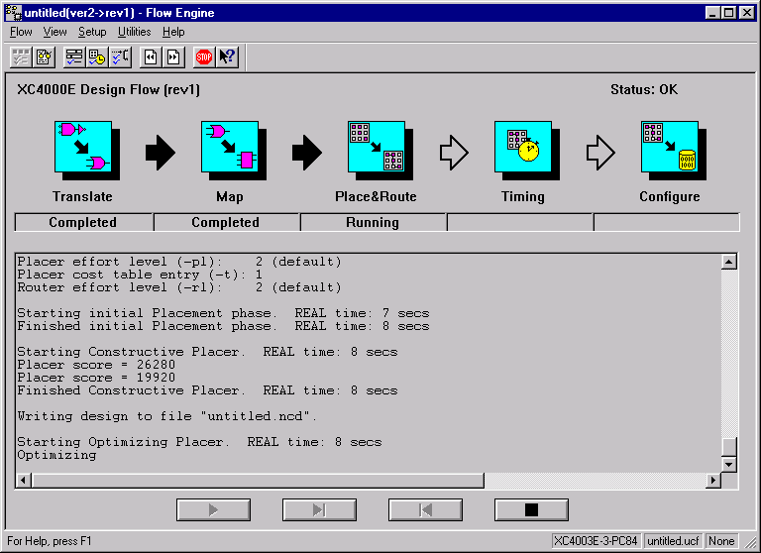
Technology mapping:
FPGA
Technology
mapping

Slide 74
Design of Combinatorial Circuits
Minimization of Boolean functions
Technology mapping
Correct timing behavior
Basic RTL building blocks (Adder, ALU, MUX, …)

Slide 75
Correct timing behavior:
Hazard-free design
z
y
x
x
x
x
x
x
x
x
a
a
a
a
a
a
a
a
y’
y’
y’
y’
y’
y’
y’
1
y’
F
F
F
F
F
F
F
F
y
y
y
y
y
y
y
y
1
1
1
1
1
x
1
z
z
z
z
z
z
z
z
b
b
b
b
b
b
b
b
0
1
2
3
4
5
6
x
y
z
y’
a
b
F
Static 1-hazard

Slide 76
Correct timing behavior:
Hazard-free design
The hazard condition causes an unwanted glitch!
Static 1-hazard: the output had to stay 1 but became briefly 0
Cause: different delay in two paths
Solution: see next slide

Slide 77
Correct timing behavior:
Hazard-free design
z
y
x
x
x
x
x
x
a
a
a
a
a
a
y’
y’
y’
y’
y’
y’
F
F
F
F
F
F
y
y
y
y
y
1
y
b
b
b
b
b
b
z
z
z
z
z
1
1
z
1
1
1
x
1
c
c
c
c
c
c
0
1
2
3
4
5
6
x
y
z
y’
a
b
c
F

Slide 78
Correct timing behavior:
Hazard-free design
Dynamic hazard: the output had to switch (eg. from 1 to 0) but switched several times (bvb. 1 → 0 → 1 → 0)
Cause: different delay in multiple paths
Example: see next slide

Slide 79
Correct timing behavior:
Hazard-free design
x’
x’
x’
x’
x’
x’
x’
x’
x’
x’
x’
x’
x’’
x’’
x’’
x’’
x’’
x’’
x’’
x’’
x’’
x’’
x’’
x’’
a
a
a
a
a
a
a
a
a
a
a
a
F
F
F
F
F
F
F
F
F
F
F
x
F
0
1
2
3
4
5
6
7
8
9
x
x’
x’’
a
F
Statically equivalent to:
x
F

Slide 80
Correct timing behavior:
Hazard-free design
Hazards are hard to detect by hand: importance of simulation
The danger for hazards increases when rise times and fall times are not equal
Are hazards a problem?
  For synchronous circuits, they are not
  Unless they control the clock of a memory element
  For asynchronous circuits, they always are a problem
  This is why asynchronous design is heavily demotivated for FPGAs (the delay of the different paths is only known after APR-Automatic Placement and Routing)

Slide 81
Design of Combinatorial Circuits
Minimization of Boolean functions
Technology mapping
Correct timing behavior
Basic RTL building blocks
  Ripple-carry adders
  Carry-look-ahead adders
  Adder/subtractors
  Multipliers
  Logic units
  Arithmetic-logic units
  Decoders
  Selectors
  Buses
  Priority encoders
  Magnitude comparators
  Shifters and rotators

Slide 82
Design of Combinatorial Circuits
Minimization of Boolean functions
Technology mapping
Correct timing behavior
Basic RTL building blocks
  Ripple-carry adders
  Carry-look-ahead adders
  Adder/subtractors
  Multipliers
  Logic units
  Arithmetic-logic units
  Decoders
  Selectors
  Buses
  Priority encoders
  Magnitude comparators
  Shifters and rotators

Slide 83
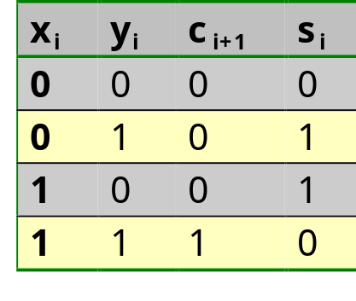
Ripple-carry adders
Half adder
c_{i+1}
y_{i}
s_{i}
y_{i}
0
0
0
1
x_{i}
0
1
x_{i}
1
0
x_{i}
y_{i}
x_{i}
y_{i}
c_{i+1}
HA
c_{i+1}
s_{i}
1 CLB
s_{i}

Slide 84
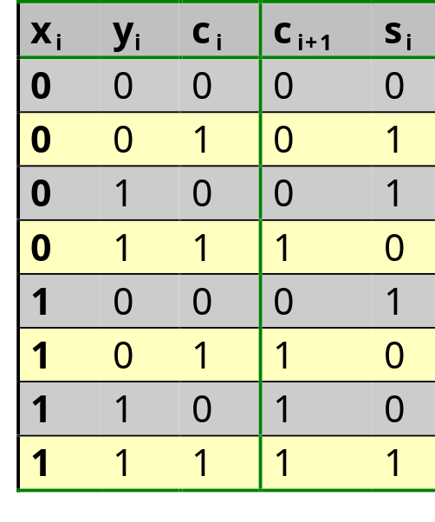
Ripple-carry adders
Full adder
y_{i}
y_{i}
c_{i+1}
x_{i}
s_{i}
x_{i}
1
1
1
c_{i}
1
1
1
c_{i}
1
1
x_{i}
y_{i}
c_{i}
1 CLB
c_{i+1}
s_{i}

Slide 85
Ripple-carry adders
Full adder: alternative implementation
y_{i}
y_{i}
c_{i+1}
x_{i}
s_{i}
x_{i}
1
1
1
c_{i}
1
1
1
c_{i}
1
1
x_{i}
y_{i}
c_{i}
1 gate less, larger delay
from x_{i}&y_{i} to c_{i+1}, same delay
from c_{i} to c_{i+1}
x_{i}
y_{i}
c_{i+1}
FA
c_{i}
s_{i}
s_{i}
c_{i+1}

Slide 86
Ripple-carry adders
4-bit ripple-carry adder
x₃
y₃
x₂
y₂
x₁
y₁
x₀
y₀
c₄
FA
c₃
FA
c₂
FA
c₁
FA
c₀=0
s₃
s₂
s₁
s₀
Critical path: x₀ or y₀ to c₄: 1 XOR + 4 AND + 4 OR
In principal 1 CLB per bit
Because of special circuitry (dedicated carry chain):
1 CLB per 2 bits

Slide 87
Design of Combinatorial Circuits
Minimization of Boolean functions
Technology mapping
Correct timing behavior
Basic RTL building blocks
  Ripple-carry adders
  Carry-look-ahead adders
  Adder/subtractors
  Multipliers
  Logic units
  Arithmetic-logic units
  Decoders
  Selectors
  Buses
  Priority encoders
  Magnitude comparators
  Shifters and rotators

Slide 88
Carry-look-ahead adders
Ripple-carry adder is slow because the critical path x₀ to c_{n+1} is long
Speed-up is possible by computing for example c₄ directly (in principle in 2 layers of logic) from c₀, x₀…x₃ en y₀…y₃. Hence the name Carry-look-ahead
How is this done? See exercises and course book
x_{i…i+3}
y_{i…i+3}
4-bit CLA
c_{i+4}
c_{i}
s_{i…i+3}

Slide 89
Design of Combinatorial Circuits
Minimization of Boolean functions
Technology mapping
Correct timing behavior
Basic RTL building blocks
  Ripple-carry adders
  Carry-look-ahead adders
  Adder/subtractors
  Multipliers
  Logic units
  Arithmetic-logic units
  Decoders
  Selectors
  Buses
  Priority encoders
  Magnitude comparators
  Shifters and rotators

Slide 90
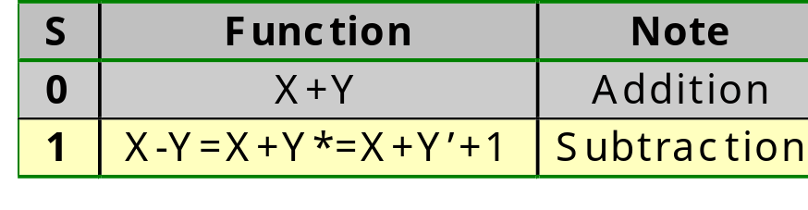
Adder-subtractors
X
Y
C_{out}
Adder/
subtractor
S
F
x₃
y₃
x₂
y₂
x₁
y₁
x₀
y₀
S
c₄
FA
c₃
FA
c₂
FA
c₁
FA
c₀
f₃
f₂
f₁
f₀
overflow
Only for 2-complement!!!

Slide 91
Design of Combinatorial Circuits
Minimization of Boolean functions
Technology mapping
Correct timing behavior
Basic RTL building blocks
  Ripple-carry adders
  Carry-look-ahead adders
  Adder/subtractors
  Multipliers
  Logic units
  Arithmetic-logic units
  Decoders
  Selectors
  Buses
  Priority encoders
  Magnitude comparators
  Shifters and rotators

Slide 92
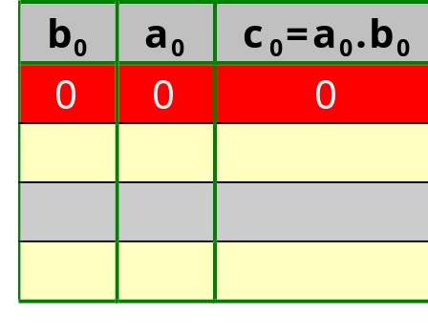
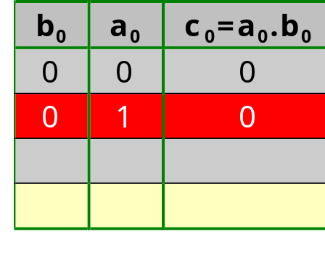
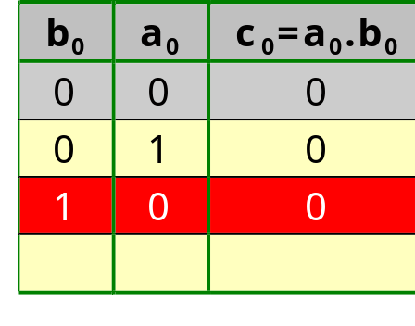
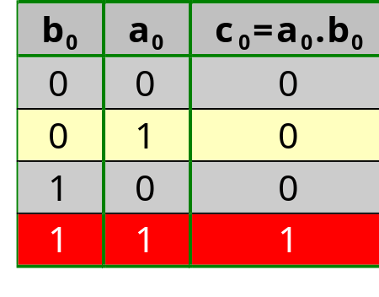
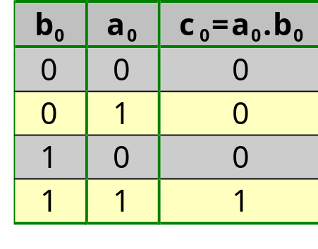
Multipliers
A 1-bit by 1-bit multiplier:
C = B • A
b₀
a₀
a₀b₀
A 1-bit by 1-bit multiplier is hence an AND gate
a₀
b₀
c₀

Slide 93
Multipliers
A 2-bit by 2-bit multiplier:
C = B • A
a₀
b₀
b₁
b₀
b₁
a₁
a₀
a₁
b₀
a₀b₁
a₀b₀
b₁
a₁b₁
a₁b₀
c₃
c₂
c₁
c₀
HA
HA
c₃
c₂
c₁
c₀
Each of these
terms is a
1-bit by 1-bit
multiplier: AND

Slide 94
Multipliers
A 4-bit by 3-bit multiplier: cost=O(n²)
a₀
b₀
b₃
b₂
b₁
a₁
b₀
b₃
b₂
b₁
0
4-bit adder
c_{out}
s₃
s₂
s₁
s₀
a₂
b₀
b₃
b₂
b₁
4-bit adder
c_{out}
s₃
s₂
s₁
s₀
c₆
c₅
c₄
c₃
c₂
c₁
c₀

Slide 95
Design of Combinatorial Circuits
Minimization of Boolean functions
Technology mapping
Correct timing behavior
Basic RTL building blocks
  Ripple-carry adders
  Carry-look-ahead adders
  Adder/subtractors
  Multipliers
  Logic units
  Arithmetic-logic units
  Decoders
  Selectors
  Buses
  Priority encoders
  Magnitude comparators
  Shifters and rotators

Slide 96
Logic units
Goal: implement a unit that can realise all 16 Boolean functions of 2 bits
The unit has two inputs X and Y and 4 select bits S₃S₂S₁S₀ that select the wanted function
The coding of the select bits is identical to the function number in the table of possible Boolean functions

Slide 97
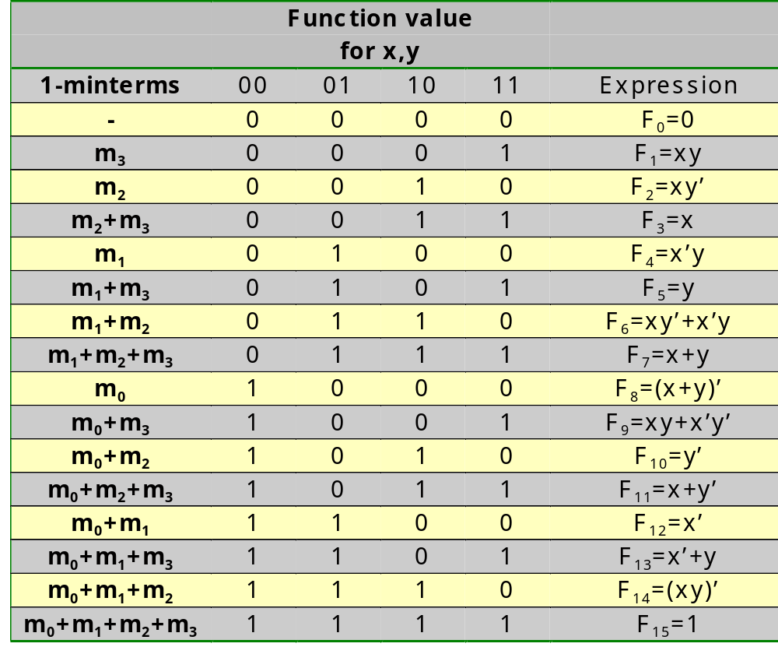
Logic units

Slide 98
Logic units
x_{i}
y_{i}
S₀
S₁
S₂
x_{i}
y_{i}
S₃
LU
S_{0..3}
f_{i}
f_{i}

Slide 99
Design of Combinatorial Circuits
Minimization of Boolean functions
Technology mapping
Correct timing behavior
Basic RTL building blocks
  Ripple-carry adders
  Carry-look-ahead adders
  Adder/subtractors
  Multipliers
  Logic units
  Arithmetic-logic units
  Decoders
  Selectors
  Buses
  Priority encoders
  Magnitude comparators
  Shifters and rotators

Slide 100
Arithmetic-logic units
Goal: build a unit that realises 4 arithmetic operations (addition, subtraction, increment and decrement) and 4 logic operations (AND, OR, INV, identity)
Realisation principle: use an adder in front of which we place a modifier circuit (Arithmetic-Logic Extender)
This principle has already been applied for the 2-complement adder/subtractor: this was an adder in front of which we placed an exor circuit to allow for subtraction

Slide 101
Arithmetic-logic units
a₄
b₄
a₃
b₃
a₂
b₂
a₁
b₁
a₀
b₀
S
FA
FA
FA
FA
FA
C_{out}
f₄
f₃
f₂
f₁
f₀
S selects the function to be executed:
0=addition, 1=subtraction

Slide 102
Arithmetic-logic units
a₄
b₄
a₃
b₃
a₂
b₂
a₁
b₁
a₀
b₀
S₀₁
M
ALE
ALE
ALE
ALE
ALE
X
Y
FA
FA
FA
FA
FA
C_{out}
f₄
f₃
f₂
f₁
f₀
M selects the type of operation: 0=logic, 1=arithmetic
S₀ and S₁ select the operation

Slide 103
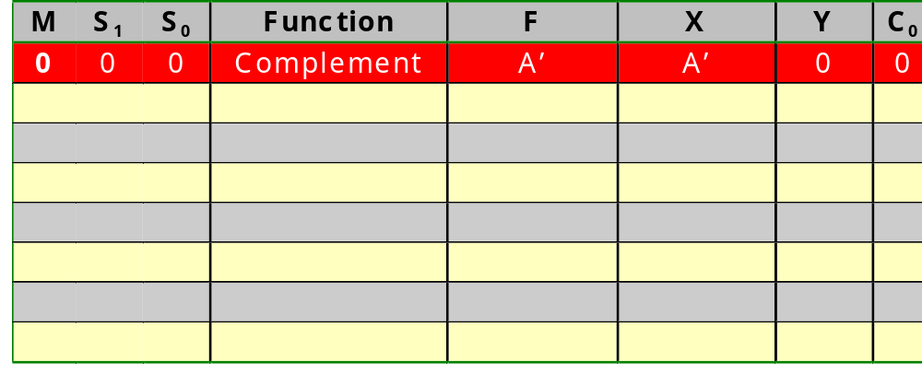
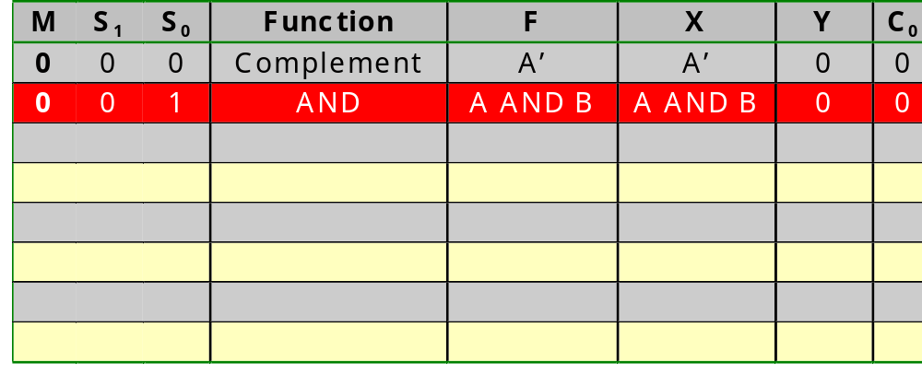
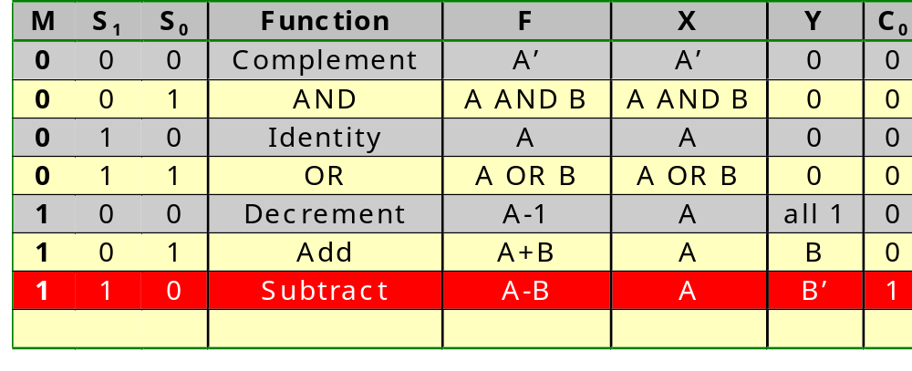
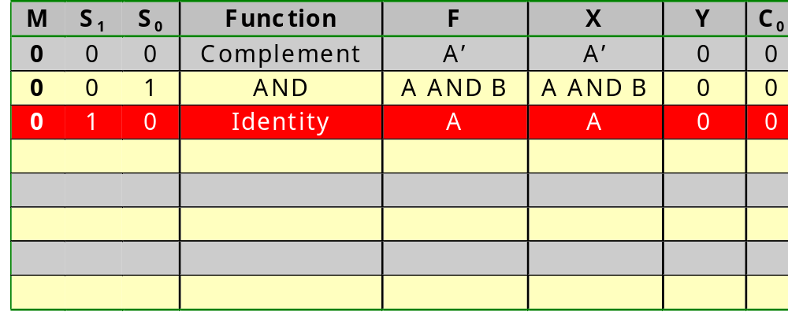
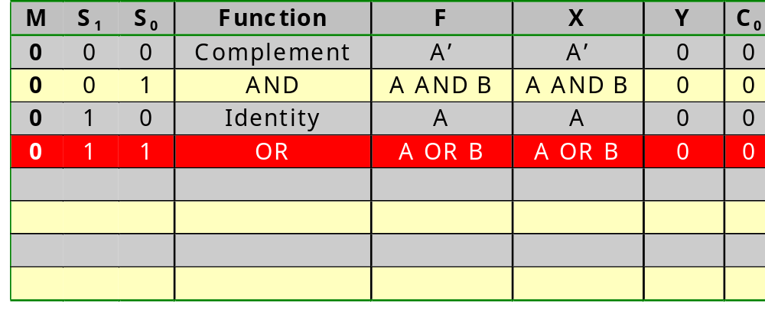
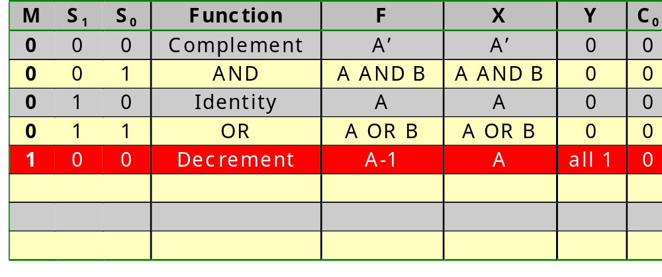
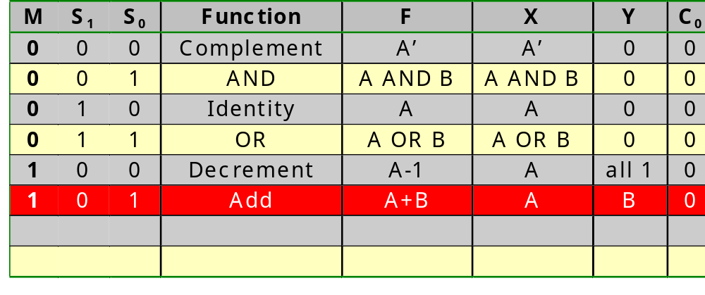
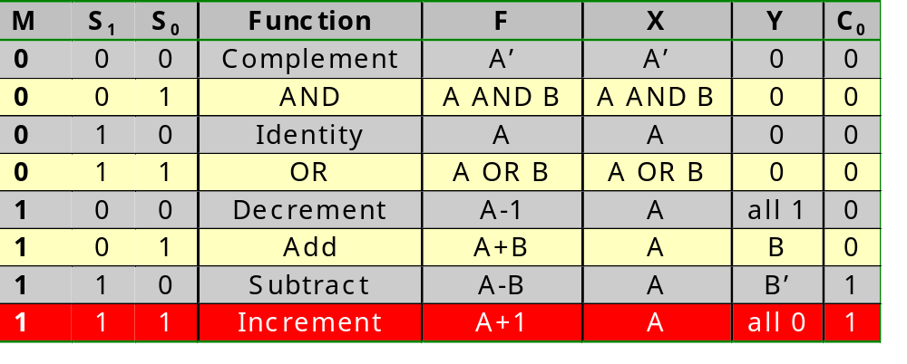
Arithmetic-logic units

Slide 104
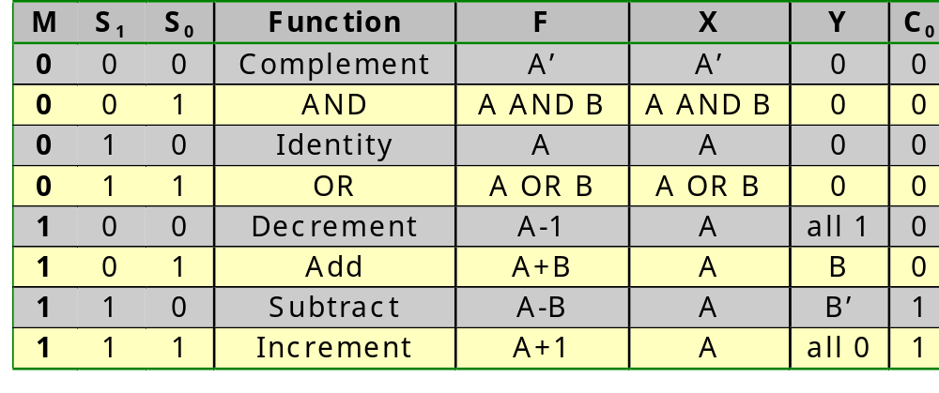
Arithmetic-logic units
S₀
c₀
M
S₁
S₁
M
1
1
c₀

Slide 105
Arithmetic-logic units
a
M
b
S₀
S₀
S₀
X
S₁
S₁
S₁
M
1
b_{i}
1
1
a_{i}
1
1
1
1
1
1
1
1
1
1
1
1
1
X

Slide 106
Arithmetic-logic units
a
M
b
S₀
S₀
S₀
Y
S₁
S₁
S₁
M
1
1
b_{i}
1
1
a_{i}
1
1
1
1
Y

Slide 107
Arithmetic-logic units
a₄
b₄
a₃
b₃
a₂
b₂
a₁
b₁
a₀
b₀
S₀₁
M
ALE
ALE
ALE
ALE
ALE
X
Y
FA
FA
FA
FA
FA
C_{out}
f₄
f₃
f₂
f₁
f₀

Slide 108
Design of Combinatorial Circuits
Minimization of Boolean functions
Technology mapping
Correct timing behavior
Basic RTL building blocks
  Ripple-carry adders
  Carry-look-ahead adders
  Adder/subtractors
  Multipliers
  Logic units
  Arithmetic-logic units
  Decoders
  Selectors
  Buses
  Priority encoders
  Magnitude comparators
  Shifters and rotators

Slide 109
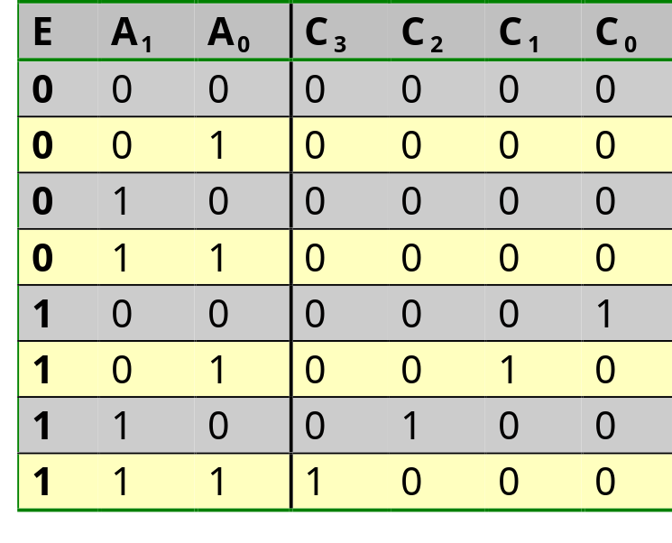
Decoders
E
A₁
A₀
C₃
C₂
C₁
C₀
A_{1..0}
E
Decoder
C_{3..0}
2 CLB

Slide 110
Decoders
A_{3..2}
E
Decoder
A_{1..0}
A_{1..0}
A_{1..0}
A_{1..0}
E
Decoder
E
Decoder
E
Decoder
E
Decoder
C_{15..12}
C_{11..8}
C_{7..4}
C_{3..0}

Slide 111
Design of Combinatorial Circuits
Minimization of Boolean functions
Technology mapping
Correct timing behavior
Basic RTL building blocks
  Ripple-carry adders
  Carry-look-ahead adders
  Adder/subtractors
  Multipliers
  Logic units
  Arithmetic-logic units
  Decoders
  Selectors
  Buses
  Priority encoders
  Magnitude comparators
  Shifters and rotators

Slide 112
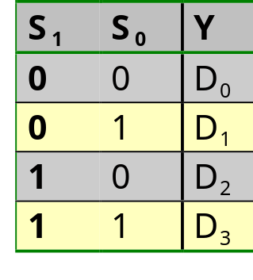
Selectors
D₃
D₂
D₁
D₀
S₁
S₀
Y
D_{3..0}
In principle:
2-to-1 MUX is 1/2 CLB
Due to special provisions:
4-to-1 MUX is 1 CLB
4-to-1
MUX
S_{1..0}
Y

Slide 113
Selectors
D₃
D₂
D₁
D₀
S₁
Decoder
S₀
Y
Alternative implementation

Slide 114
Selectors
D_{15..12}
D_{11..8}
D_{7..4}
D_{3..0}
S_{1..0}
S_{1..0}
S_{1..0}
S_{1..0}
4-to-1
selector
4-to-1
selector
4-to-1
selector
4-to-1
selector
S_{3..2}
4-to-1
selector
Y

Slide 115
Design of Combinatorial Circuits
Minimization of Boolean functions
Technology mapping
Correct timing behavior
Basic RTL building blocks
  Ripple-carry adders
  Carry-look-ahead adders
  Adder/subtractors
  Multipliers
  Logic units
  Arithmetic-logic units
  Decoders
  Selectors
  Buses
  Priority encoders
  Magnitude comparators
  Shifters and rotators

Slide 116
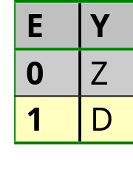
Buses
Problem with high fan-in MUX:
  fan-in OR gate too big
  all inputs have to be routed to 1 central location: substantial routing delay and difficult routing
Solution: bus with tristate drivers
D₃
D₂
D₁
D₀
S₁
S₀
Decoder
Y

Slide 117
Buses
In an FPGA (lab session) a limited number of tristate buffers is foreseen, connected to horizontal long lines. It is possible to indicate for a certain signal that we prefer to map it to a long line.
Note that a Boolean signal already can have 4 different values:
  0: the logical signal “0”
  1: the logical signal “1”
  x: don’t care
  Z: high-impedant
Simulations will allow to visualize each of the 4 different values

Slide 118
Design of Combinatorial Circuits
Minimization of Boolean functions
Technology mapping
Correct timing behavior
Basic RTL building blocks
  Ripple-carry adders
  Carry-look-ahead adders
  Adder/subtractors
  Multipliers
  Logic units
  Arithmetic-logic units
  Decoders
  Selectors
  Buses
  Priority encoders
  Magnitude comparators
  Shifters and rotators

Slide 119
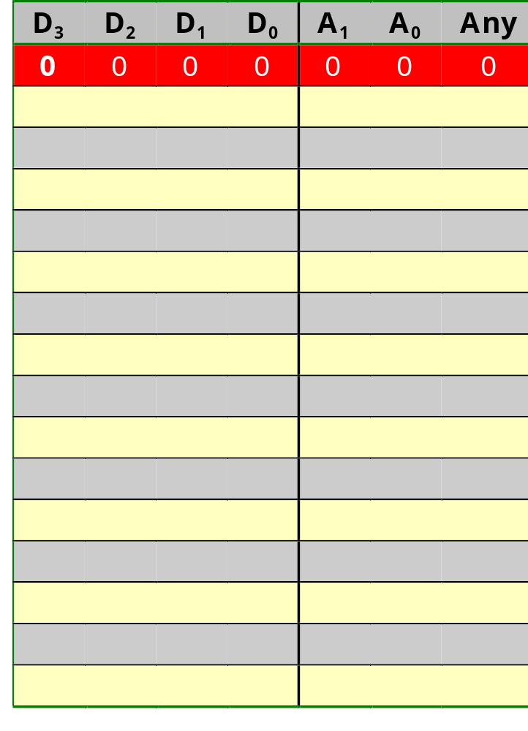
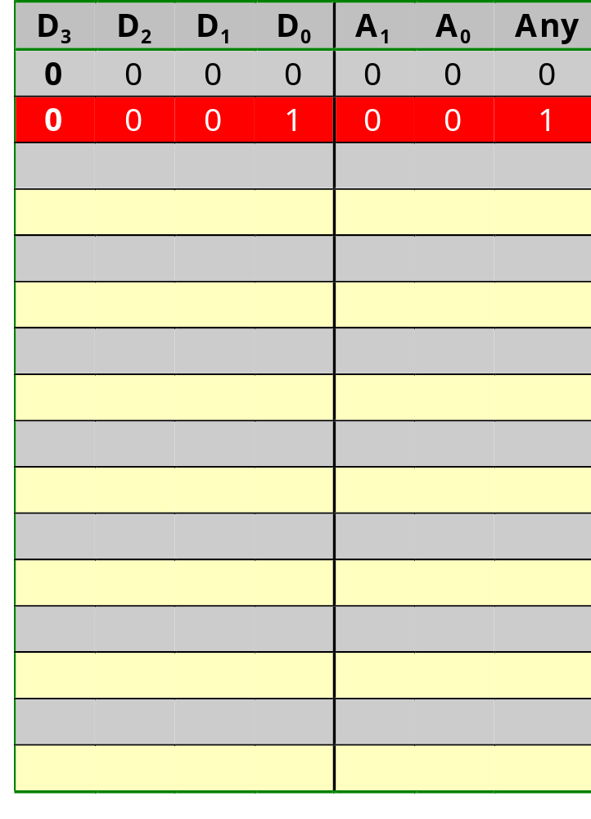




Priority encoders
D₀
Any
D₁
0
D₂
D₃
D₀
A₁
D₁
0
0
0
0
D₂
D₃
D₀
A₀
D₁
1
1
D₂
D₃
1
1
1
1
1
1
1
1

Slide 120
Priority encoders
D₀
Any
D₁
D₃
0
D₀
D₂
D₃
D₀
A₁
D₁
0
0
0
0
Any
A₁
A₀
D₂
D₃
D_{3..0}
D₀
A₀
D₁
Any
Priority
encoder
1 1/2 CLB
1
1
D₂
D₃
1
1
1
1
A_{1..0}
1
1
1
1

Slide 121
Priority encoders
D_{15..12}
D_{11..8}
D_{7..4}
D_{3..0}
Priority
encoder
Priority
encoder
Priority
encoder
Priority
encoder
Any
Priority
encoder
4-to-1
MUX
4-to-1
MUX
A_{3..2}
A₁
A₀

Slide 122
Design of Combinatorial Circuits
Minimization of Boolean functions
Technology mapping
Correct timing behavior
Basic RTL building blocks
  Ripple-carry adders
  Carry-look-ahead adders
  Adder/subtractors
  Multipliers
  Logic units
  Arithmetic-logic units
  Decoders
  Selectors
  Buses
  Priority encoders
  Magnitude comparators
  Shifters and rotators

Slide 123





Magnitude comparators
y₀
G
x₀
1
y₁
x₁
1
1
1
1
1
y₀
L
x₀
1
y₁
1
1
1
1
x₁
1

Slide 124
Magnitude comparators
y₀
G
x₀
x₁
x₀
1
y₁
y₀
y₁
x₁
1
1
1
1
1
y₀
L
x₀
1
G
L
1
1
1
1
y₁
X_{i}
Y_{i}
1
x₁
G_{i+1}
Comp
G_{i}
L_{i+1}
L_{i}
1 CLB

Slide 125
Magnitude comparators
x₇
y₇
x₆
y₆
x₅
y₅
x₄
y₄
x₃
y₃
x₂
y₂
x₁
y₁
x₀
y₀
G
Comp
Comp
Comp
Comp
Comp
Comp
Comp
L
x₇
y₇
x₆
y₆
x₅
y₅
x₄
y₄
x₃
y₃
x₂
y₂
x₁
y₁
x₀
y₀
Comp
Comp
Comp
Comp
Comp
Comp
Comp
G
L

Slide 126
Magnitude comparators
Simpler circuits are used for comparison with constants!!
X
X
x₇
x₆
X is
8 bits
y
y=1 when X>=64
y
y
x₇
x₆
y=1 when X=0
y=1 when X=255
x₀
y
y
y=1 when X<192
y=1 when X is even

Slide 127
Design of Combinatorial Circuits
Minimization of Boolean functions
Technology mapping
Correct timing behavior
Basic RTL building blocks
  Ripple-carry adders
  Carry-look-ahead adders
  Adder/subtractors
  Multipliers
  Logic units
  Arithmetic-logic units
  Decoders
  Selectors
  Buses
  Priority encoders
  Magnitude comparators
  Shifters and rotators

Slide 128
Shifters and rotators
Shifter:
  An input word is shifted m positions to the left or to the right
  m bits disappear at one side
  m bits are created at the other side
  For an arithmetic shift (word = 2-complement)
    For a left shift m zeros are shifted in from the right
    For a right shift m times the MSB is shifted in from the left (for 2-complement)
  For a logic shift
    It is possible to indicate which value is shifted in
  m bit left shift is multiplication with 2^{m}
  m bit right shift is division by 2^{m}

Slide 129
Shifters and rotators
Rotator:
  An input word is shifted m positions to the left or to the right
  The bits that drop-off at one side, are shifted back in at the other side

Slide 130
Shifters and rotators
S₂: 0=no shift,1=shift S₁: 0=left,1=right S₀: 0=shift,1=rotate
S₂: 0=no shift,1=shift S₁: 0=left,1=right S₀: 0=shift,1=rotate
S₂: 0=no shift,1=shift S₁: 0=left,1=right S₀: 0=shift,1=rotate
S₂: 0=no shift,1=shift S₁: 0=left,1=right S₀: 0=shift,1=rotate
S₂: 0=no shift,1=shift S₁: 0=left,1=right S₀: 0=shift,1=rotate
S₂: 0=no shift,1=shift S₁: 0=left,1=right S₀: 0=shift,1=rotate
d₀
d₁
d₂
d₃
S₂
S₁
S₀
L-in
R-in
M
M
M
M
M
M
M
M
M
M
M
M
4-to-1
MUX
4-to-1
MUX
4-to-1
MUX
4-to-1
MUX
4-to-1
MUX
4-to-1
MUX
4-to-1
MUX
4-to-1
MUX
4-to-1
MUX
4-to-1
MUX
4-to-1
MUX
4-to-1
MUX
4-to-1
MUX
4-to-1
MUX
4-to-1
MUX
4-to-1
MUX
4-to-1
MUX
4-to-1
MUX
4-to-1
MUX
4-to-1
MUX
4-to-1
MUX
4-to-1
MUX
4-to-1
MUX
4-to-1
MUX
y₃
y₃
y₃
y₃
y₃
y₃
y₂
y₂
y₂
y₂
y₂
y₂
y₁
y₁
y₁
y₁
y₁
y₁
y₀
y₀
y₀
y₀
y₀
y₀

Slide 131
Shifters and rotators
8-bit barrel left rotator
S₀
M
M
M
M
M
M
M
M
S₁
M
M
M
M
M
M
M
M
S₂
M
M
M
M
M
M
M
M

